Slide 1
Hospital Management System
Internal Guide :- Submitted By:-
Dr. Sanjay Patel
Dhruv Shah – 219BECE30006
Darshan Solanki – 18BECE30031
Devansh Patel – 18BECE30041
Rutvik Patel – 18BECE30145

Slide 2
ACKNOWLEDGEMENT
The project Hospital Management system includes registration of patients, storing their details into the system, and also computerized billing in the pharmacy and labs.
The system has the facility to give a unique id for every patient and stores the details of every patient and the staff automatically.
Hospital Management System is flexible, and easy to use and is designed and developed to deliver real conceivable benefits to hospitals.
Hospital Management System is designed to remove unnecessary paperwork.

Slide 3
Problem Definition
A system to manage the all activities in a hospital like patients , doctor appointment and details in computerized manner.

Slide 4
Hardware and Software Requirements
1. Software Requirements
Any search engines
2. Hardware Requirements
pc, laptop , mobile-phone with Proper internet connectivity

Slide 5
System Diagram

Slide 6
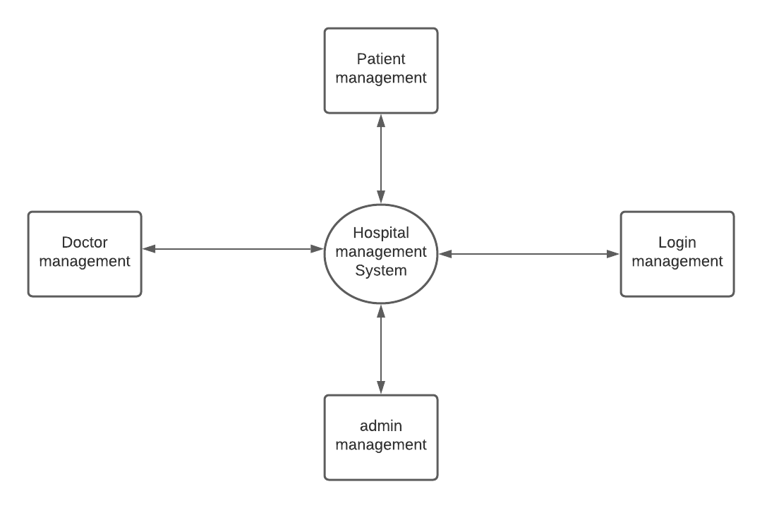
Zero-level DFD(context diagram)

Slide 7
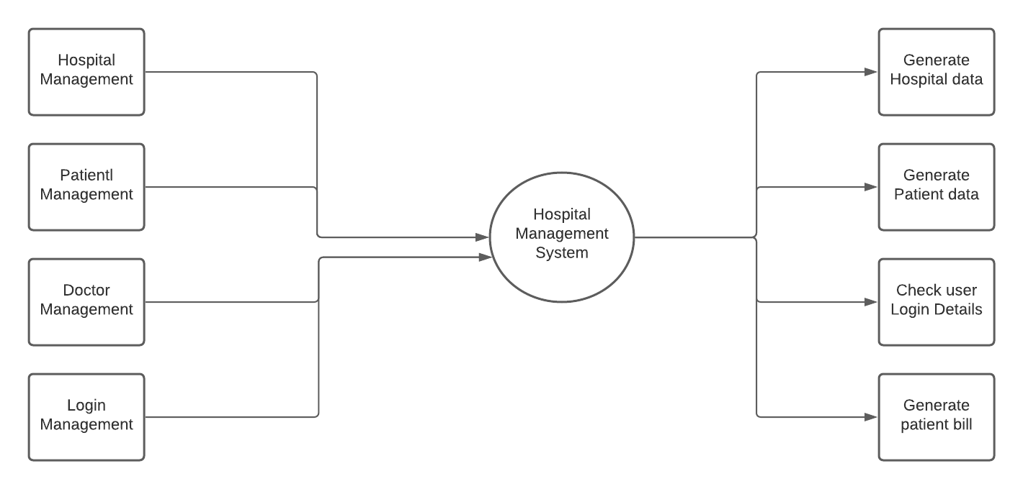
First-level DFD

Slide 8
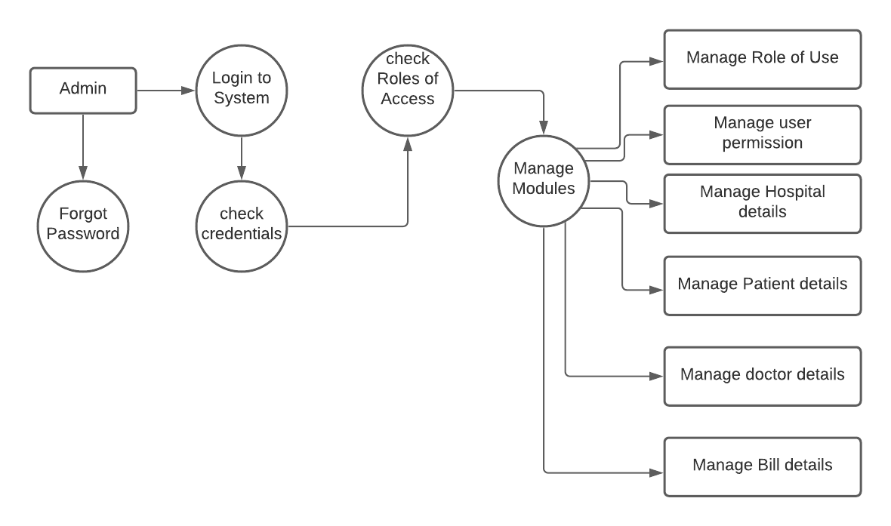
Second-level DFD

Slide 9
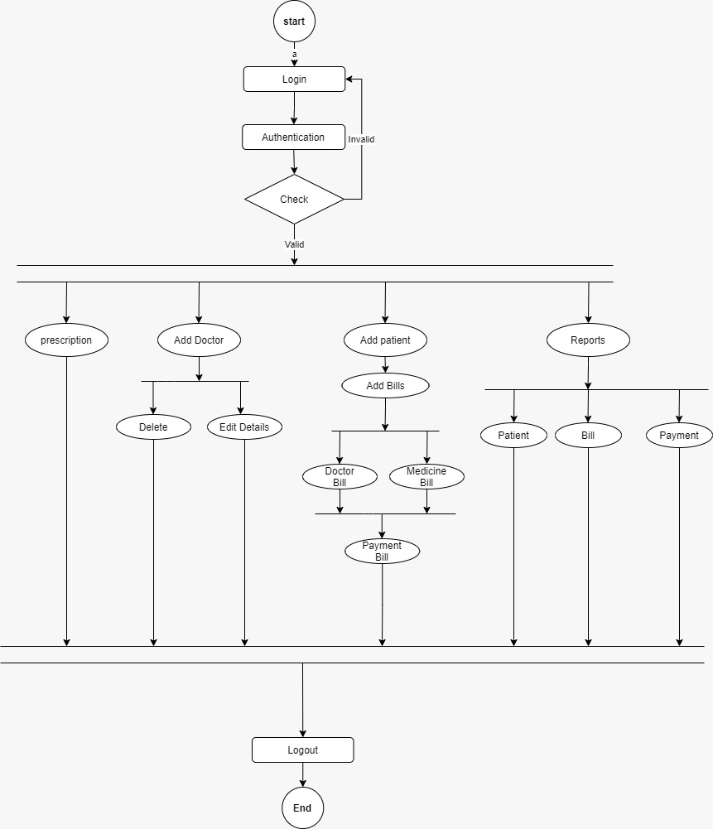
<-Activity Diagram

Slide 10
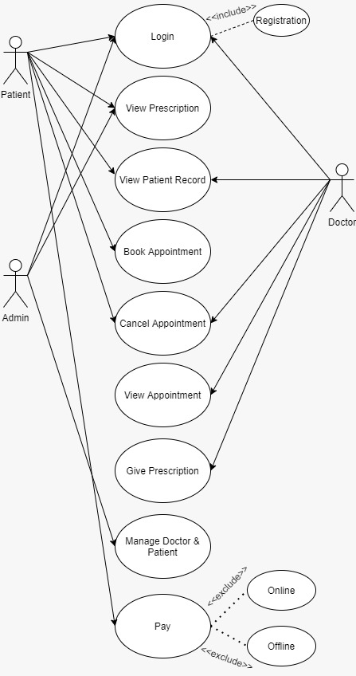
← Use-Case Diagram

Slide 11
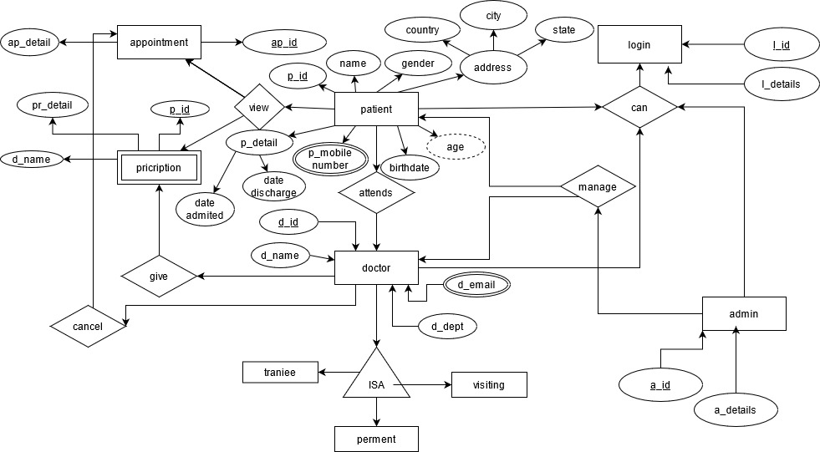
<-E-R Diagram

Slide 12
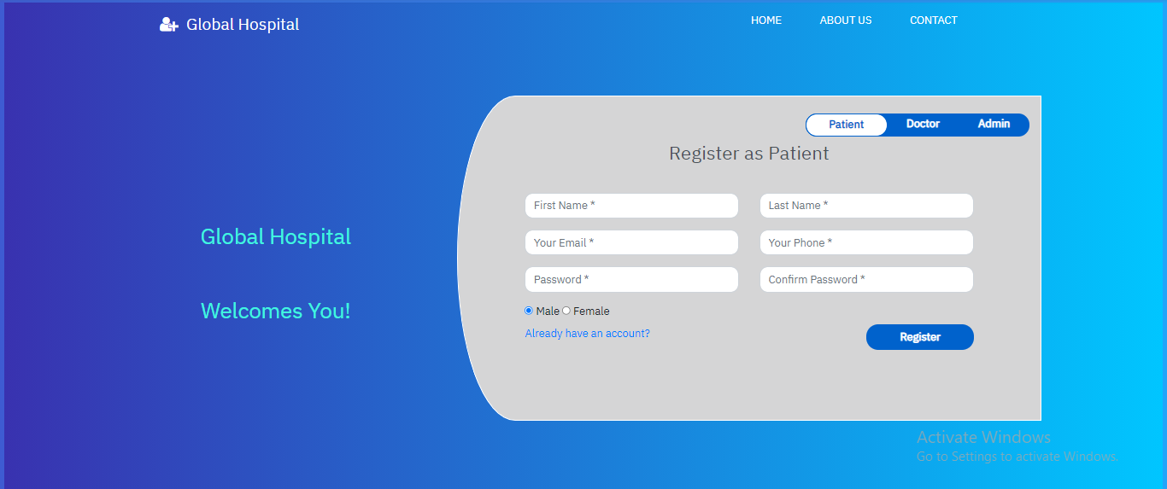
Screen Shots

Slide 13
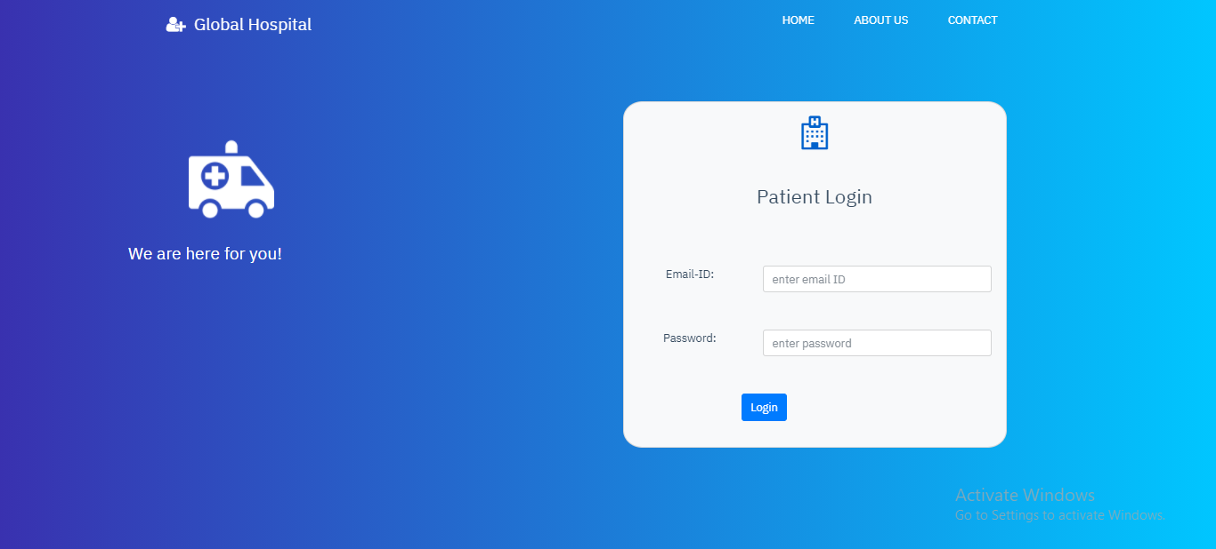

Slide 14
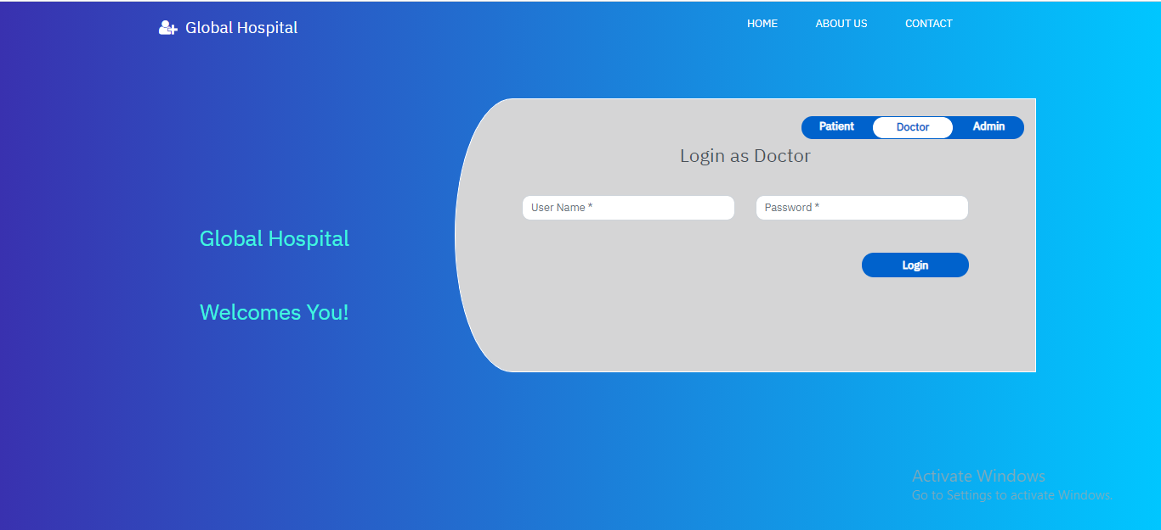

Slide 15
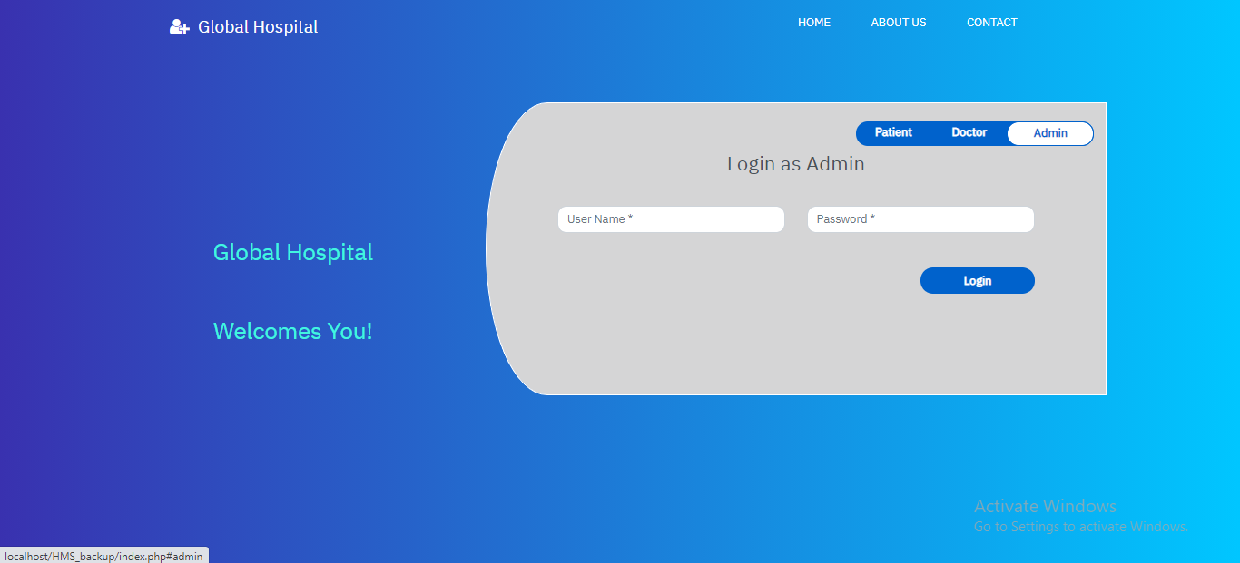

Slide 16
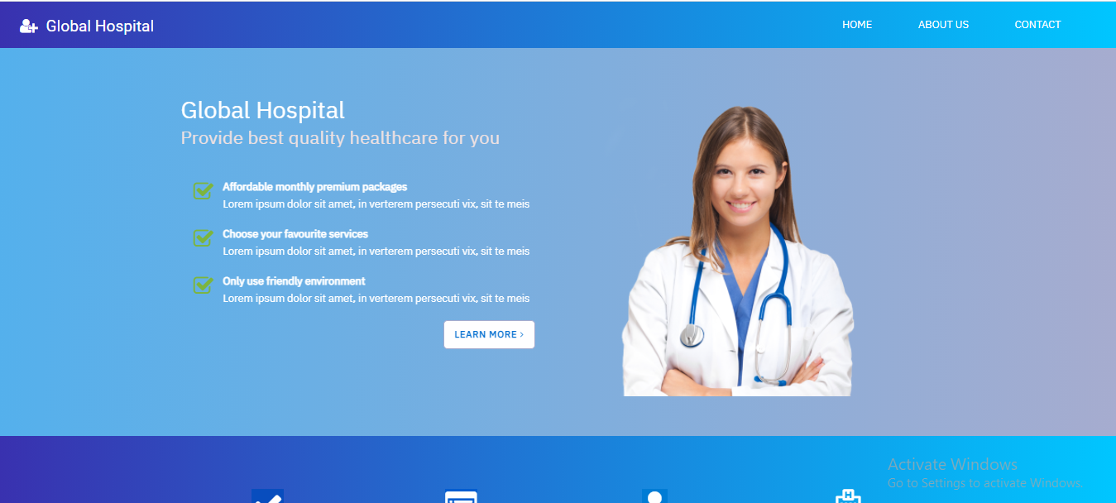

Slide 17
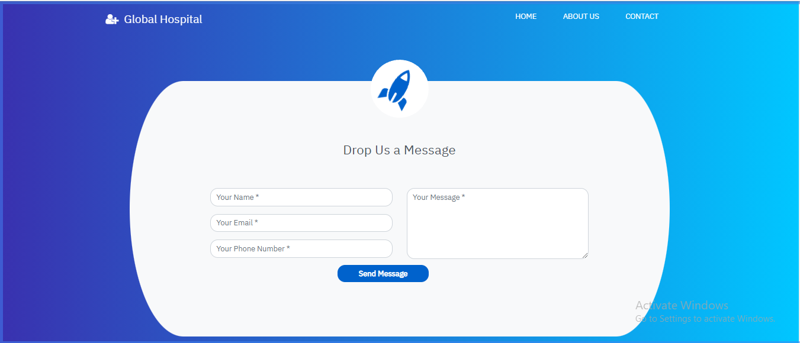

Slide 18
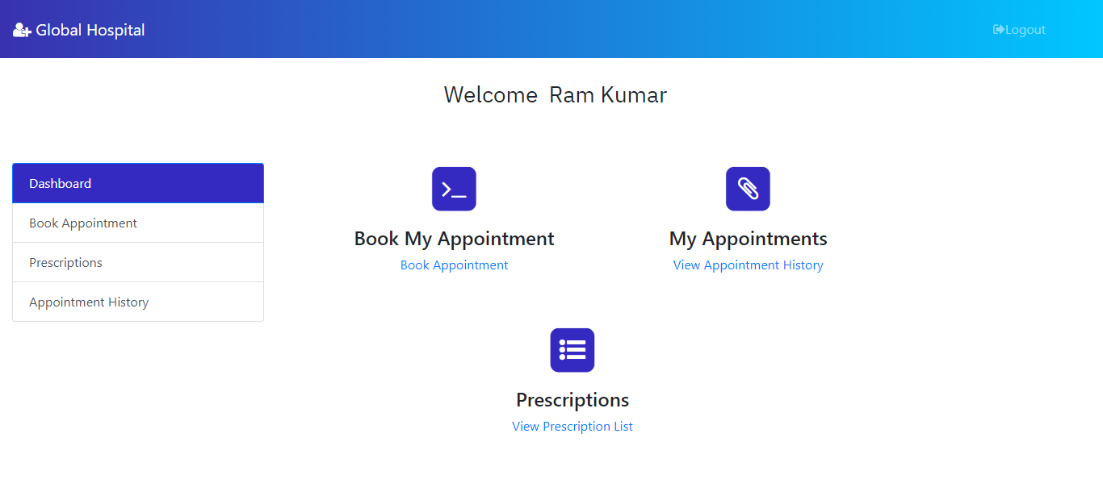

Slide 19
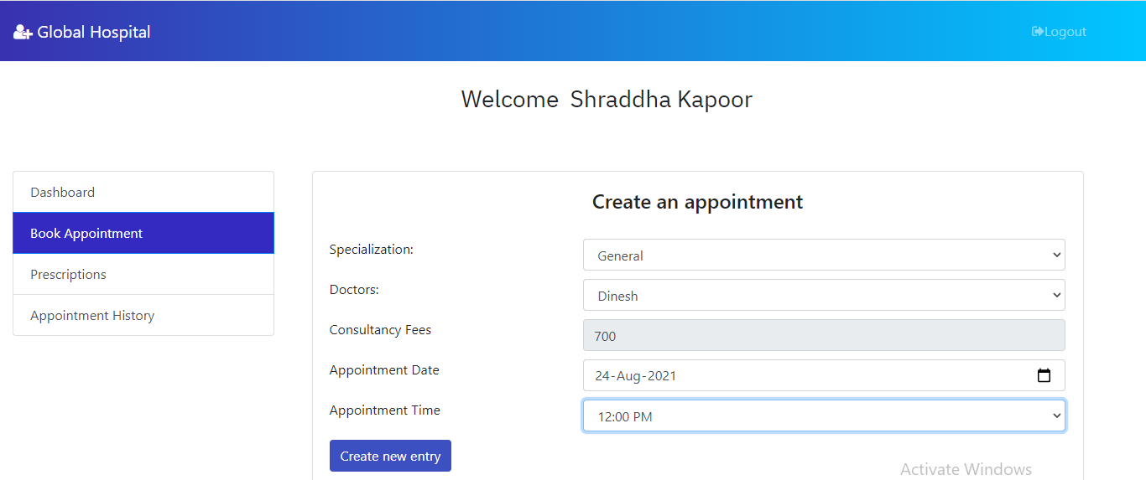

Slide 20
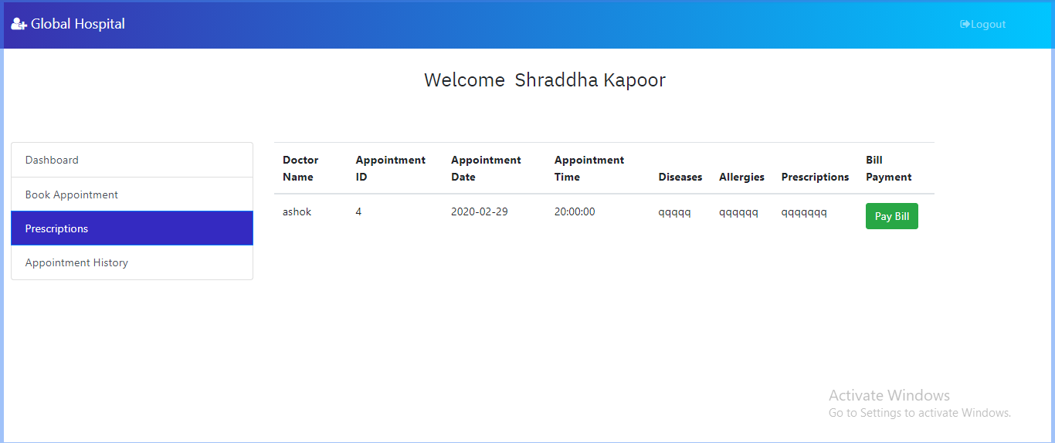

Slide 21
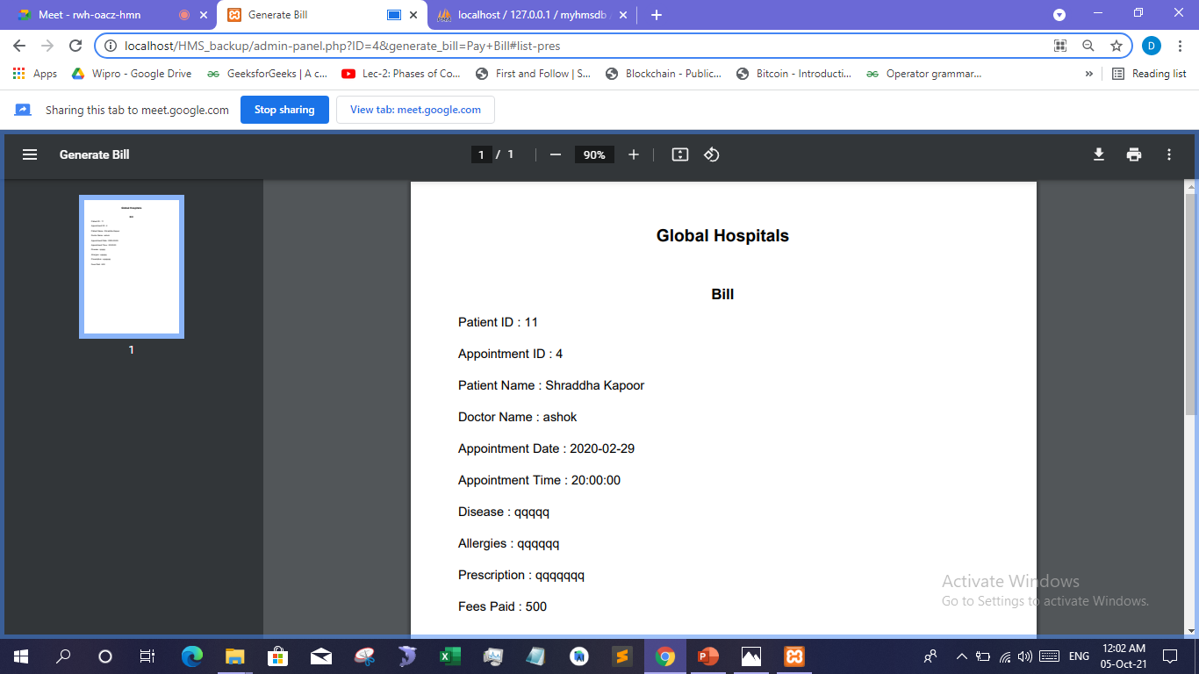

Slide 22
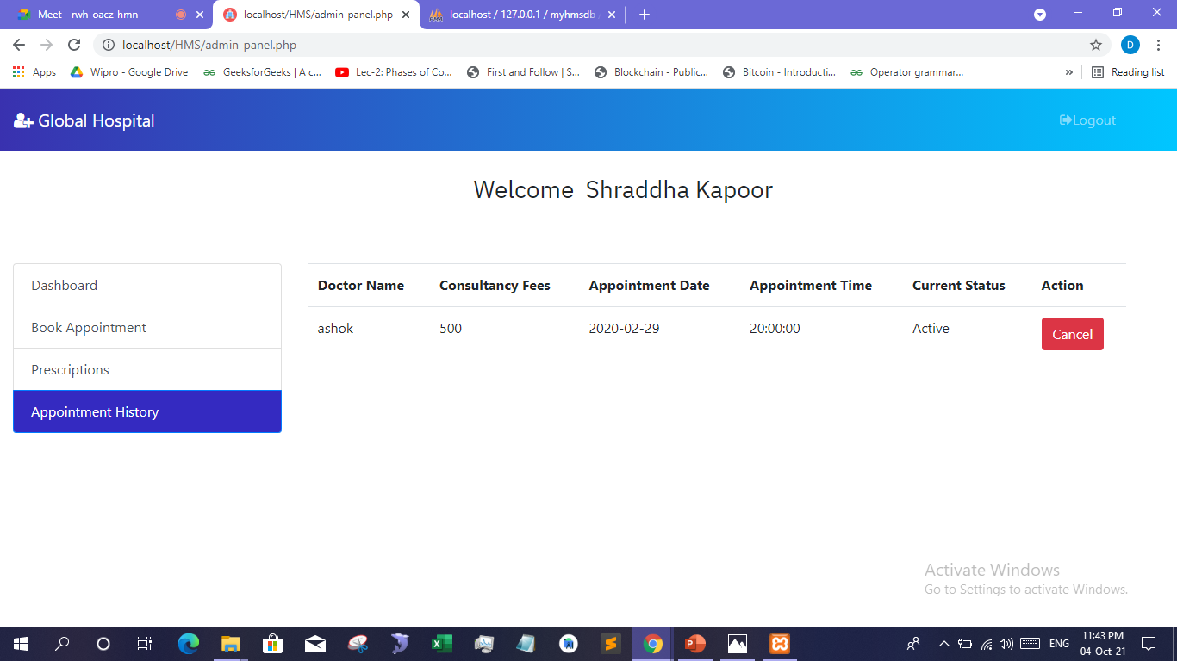

Slide 23
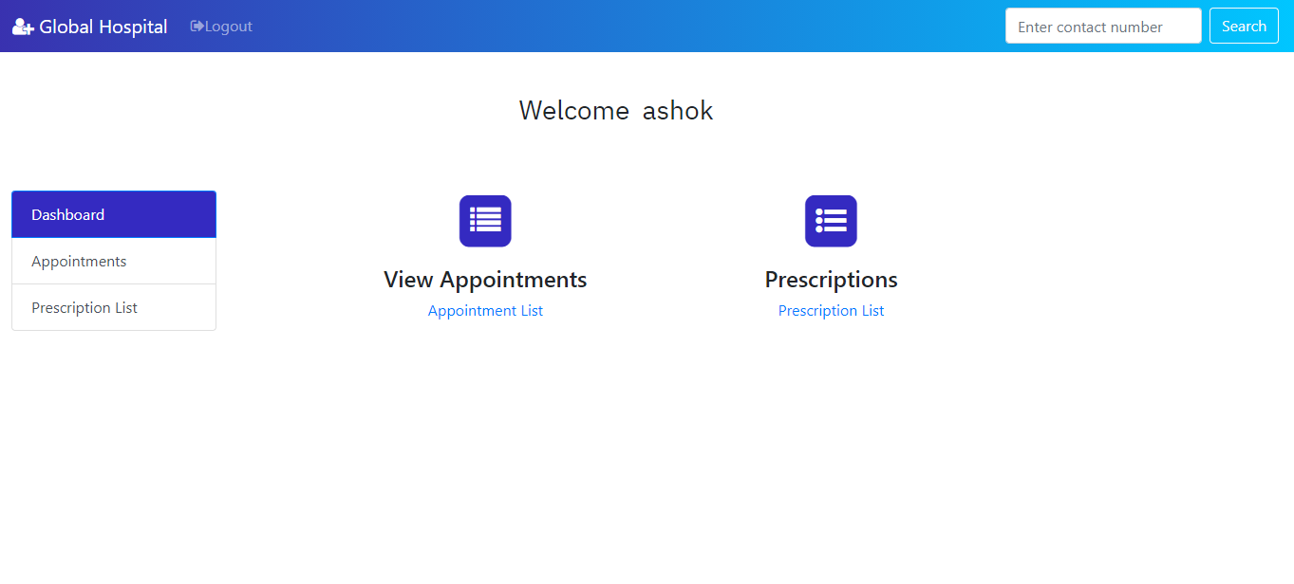

Slide 24
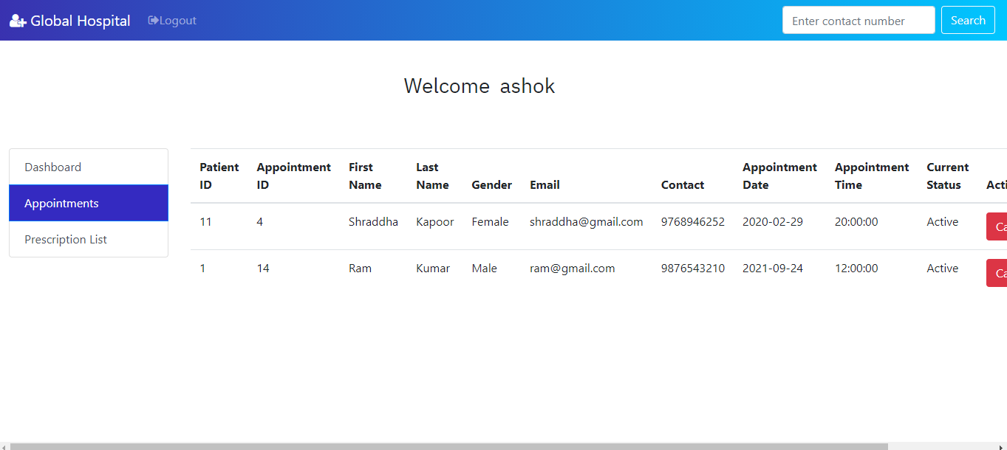

Slide 25
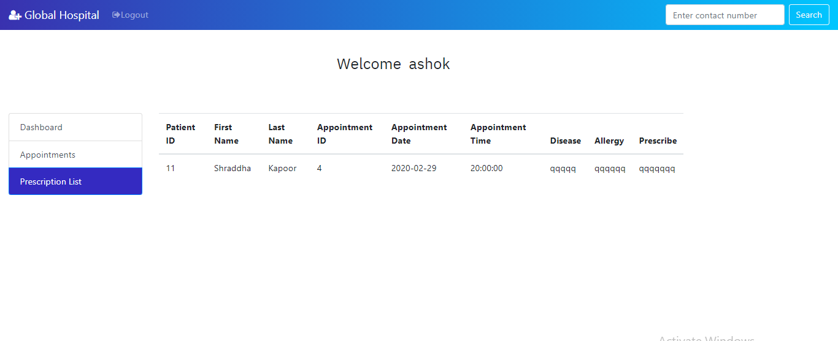

Slide 26
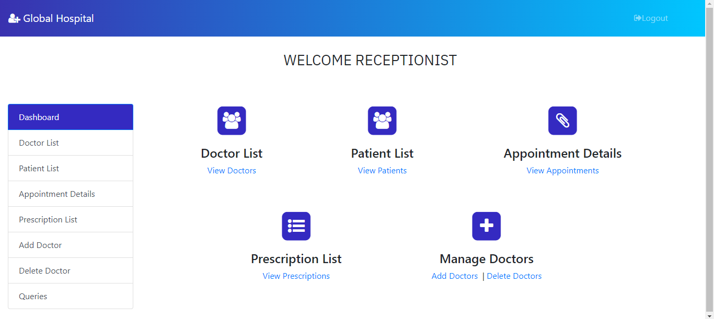

Slide 27
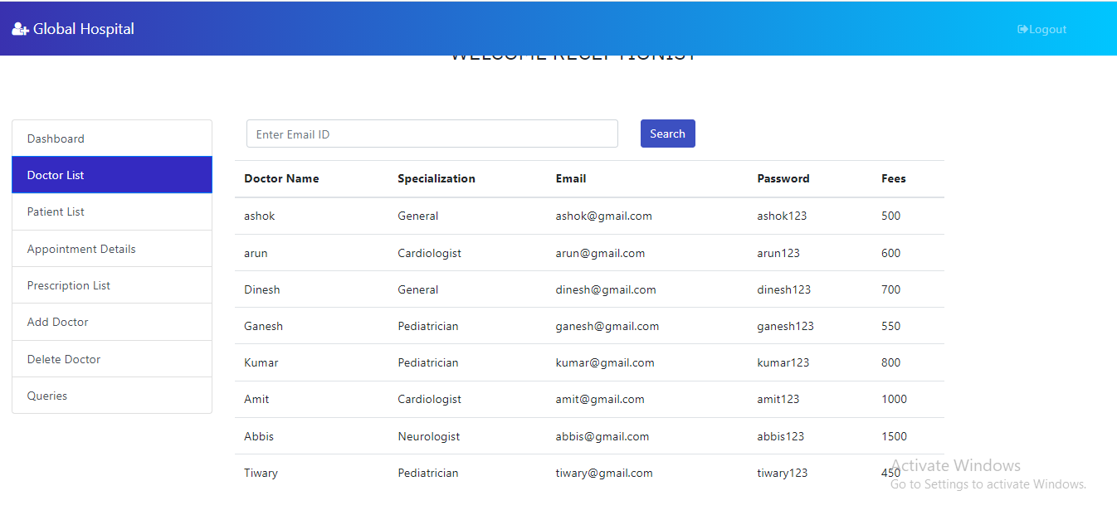

Slide 28
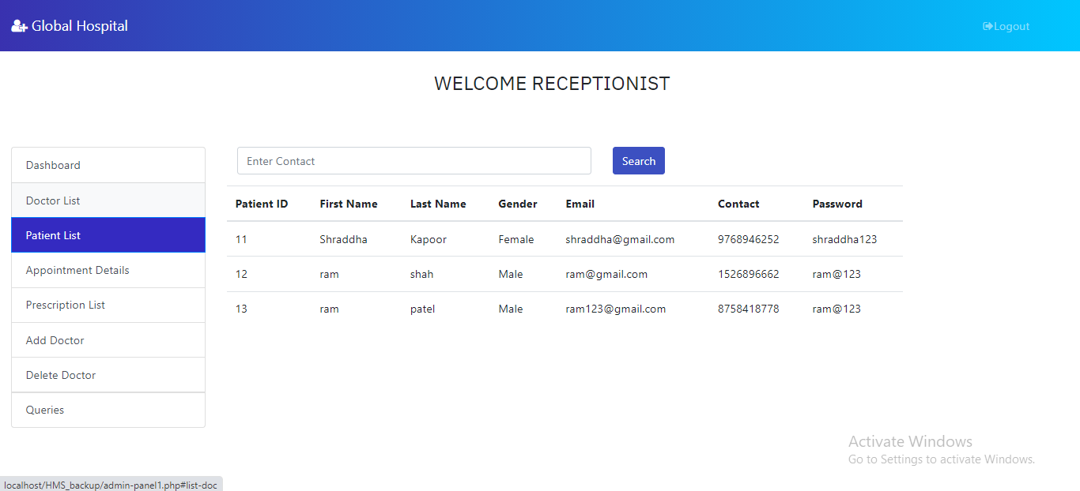

Slide 29
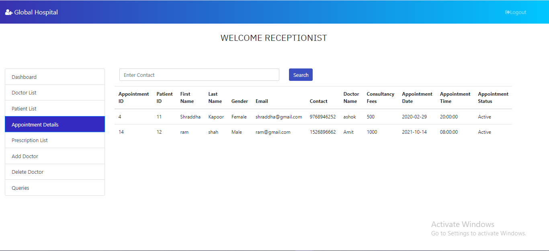

Slide 30
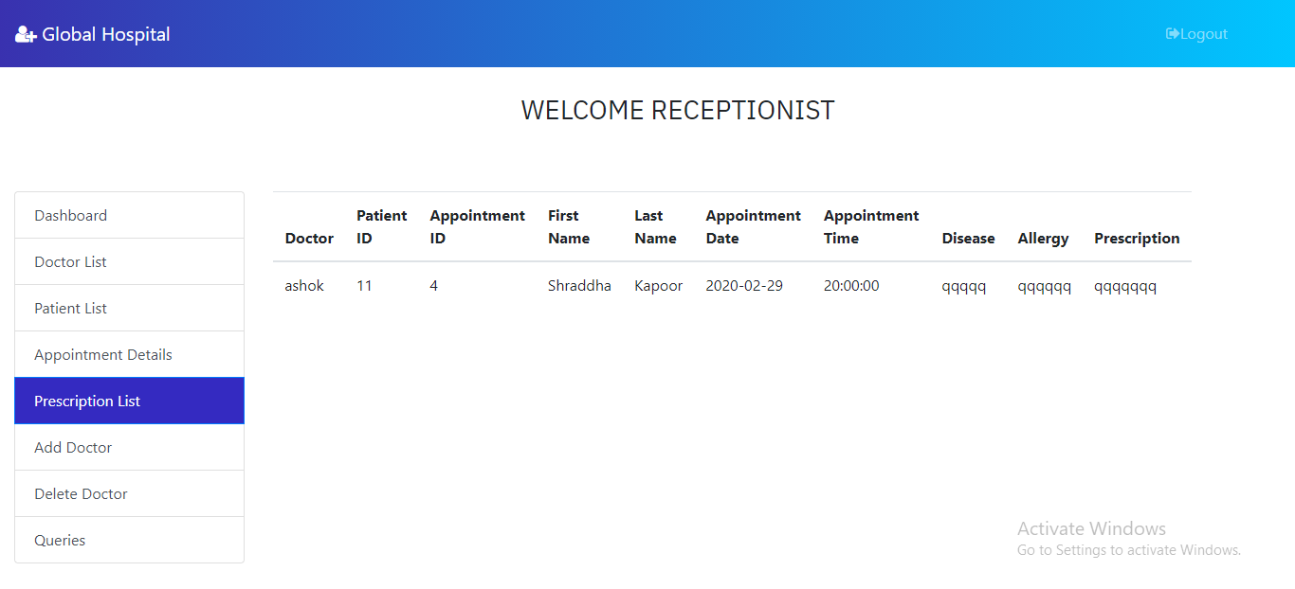

Slide 31
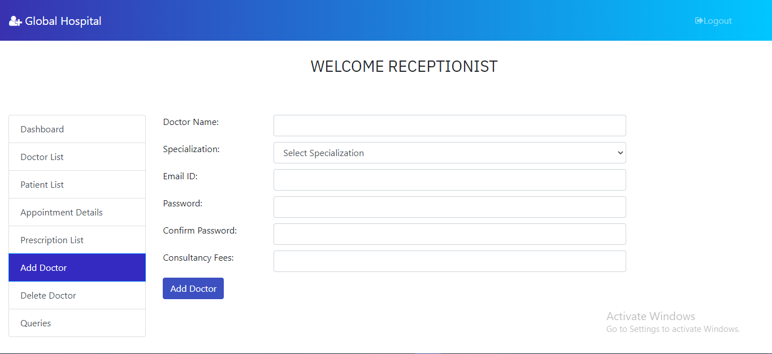

Slide 32
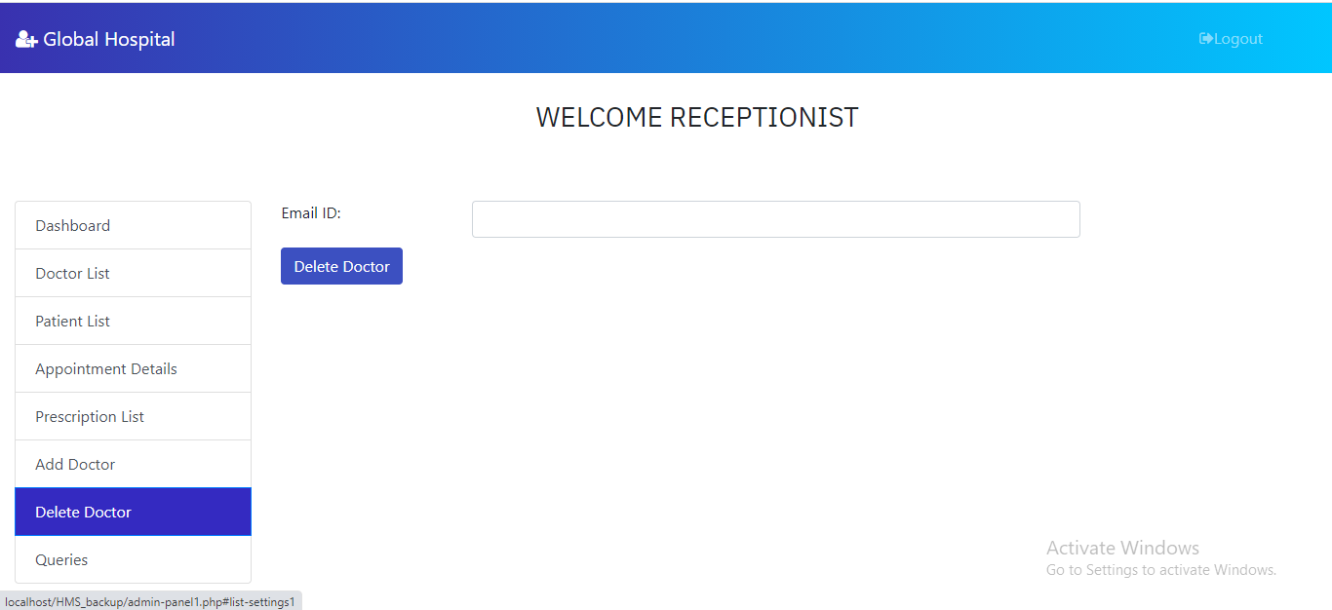

Slide 33
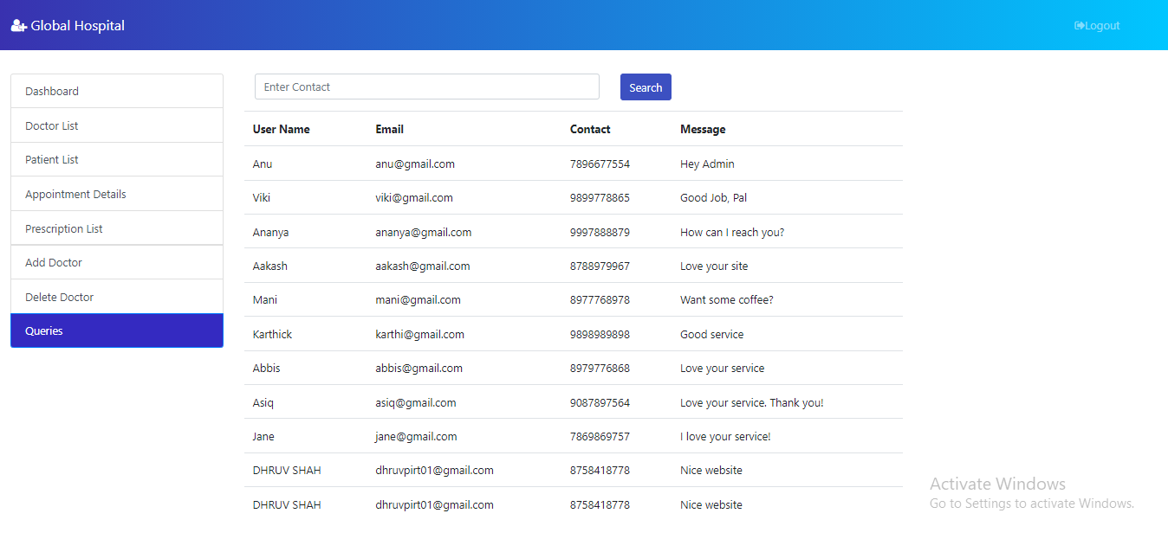

Slide 34
Future Plan
To see the patient history
Reschedule the appointment by doctor and patient
Notify user when his/her Book appointment
Support Multiple Languages like Hindi, Gujarati, French and Spanish(Espinal).

Slide 35
Conclusion
The module developed by us is very handy, user friendly and efficient.
The System made by us is perfectly suited to implement all these features.
Easy navigation is provided by us in whole project.
Apart from this is user want search he can search all the facilities so it’s saves lots of time.

Slide 36
Thank
You

